Slide 1
Scholar
A HPC resource dedicated to course teaching
Computing resource on Rice cluster
User Guide: https://www.rcac.purdue.edu/compute/scholar/
How to access the system
$ ssh zhu472@scholar.rcac.purdue.edu
zhu472@scholar.rcac.purdue.edu's password:

Slide 2
Homework 0.1
Please log in scholar.rcac.purdue.edu;
Username: <Your Purdue Career Account>
Password: < Your Purdue Career Account Password>
Make sure you have the access to Scholar, where your will finish HPC homework.
Example:
$ ssh usrename@scholar.rcac.purdue.edu
username@scholar.rcac.purdue.edu's password:

Slide 3
Intro to Supercomputing
Xiao Zhu
Senior Research Scientist
Research Computing, ITaP
ME 614
Jan. 25th, 2017

Slide 4
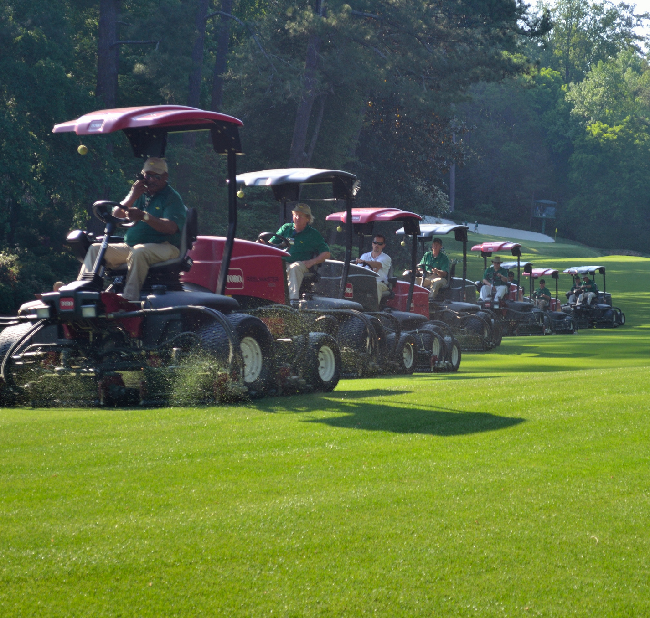

TYPES OF WORK
SERIAL VS PARALLEL
More than one mower!
Mow the lawn faster …
… or mow a bigger lawn
Lawn mowers = cores
Node
Processor
Processor
Core
Core
Core
Core
Core
Core
Core
Core
Core
Core
Core
Core
Core
Core
Core
Core
Memory
Notes:
No free lunch.
Add nodes does not mean your job will run faster and get more memory.

Slide 5
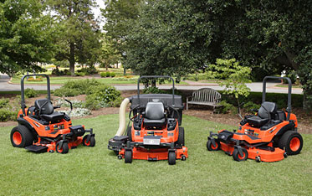
TYPES OF WORK
SERIAL VS PARALLEL
More than one mower!
Mow the lawn faster …
… or mow a bigger lawn
Lawn mowers = cores
Node
Processor
Processor
Core
Core
Core
Core
Core
Core
Core
Core
Core
Core
Core
Core
Core
Core
Core
Core
Memory
Notes:
No free lunch.
Add nodes does not mean your job will run faster and get more memory.

Slide 6
Parallel Paradiagms – Shared Memory
All cores share a common pool of memory.
The programming challenge is coordination: how to avoid computing for access to the same data.
Main programming model OpenMP:.
A single executable spawns independent threads and manages threads’ access to data.
Notes:
Add information about hadoop and spark

Slide 7
Parallel Paradiagms – Distributed Memory
Each core has its own memory, inaccessible to other cores.
The programming challenge is communication: how to share data between processes.
Main programming model: MPI (Message Passing Interface).
Every assigned core runs a separate copy of the same executable.
Notes:
Add information about hadoop and spark

Slide 8
Hybrid Architecture
Most large clusters are hybrids of these models.
Each node is a multi-core shared memory computer running its own Linux operating system.
Many such nodes connected in distributed configuration.
Each cores sees only the memory on its own node.
Notes:
Add information about hadoop and spark

Slide 9
Programming Models
Programming models vary.
Pure MPI: ignore shared memory
Pure OpenMP: confine yourself to one node
Hybrid: mix MPI and OpenMP
Accelerators/Co-processors: GPU or Intel Xeon Phi
Notes:
Add information about hadoop and spark

Slide 10
Why Do Parallel Computing?
Limits of serial computing
Processor speed, max performance
Available memory
Limited I/O capability
Parallel computing allows one to:
Solve problems that do not fit on a single CPU
Solve problems that can’t be solved in a reasonable time
So we can solve
Faster
Larger problems
More cases

Slide 11
Theoretical Limit
All parallel programs contain:
Parallel sections
Serial sections
Serial sections limit the parallel effectiveness
Amdahl’s Law places a strict limit on the speedup that can be realized by using multiple processors.
where fs = serial fraction of code
fp = parallel fraction of code
N = number of processors

Slide 12
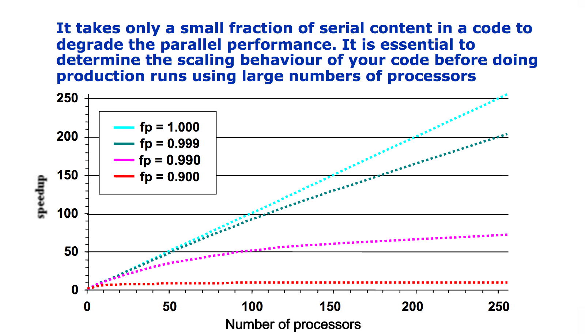
Theoretical Limit
As you add processors, you reach a point of diminishing returns!

Slide 13
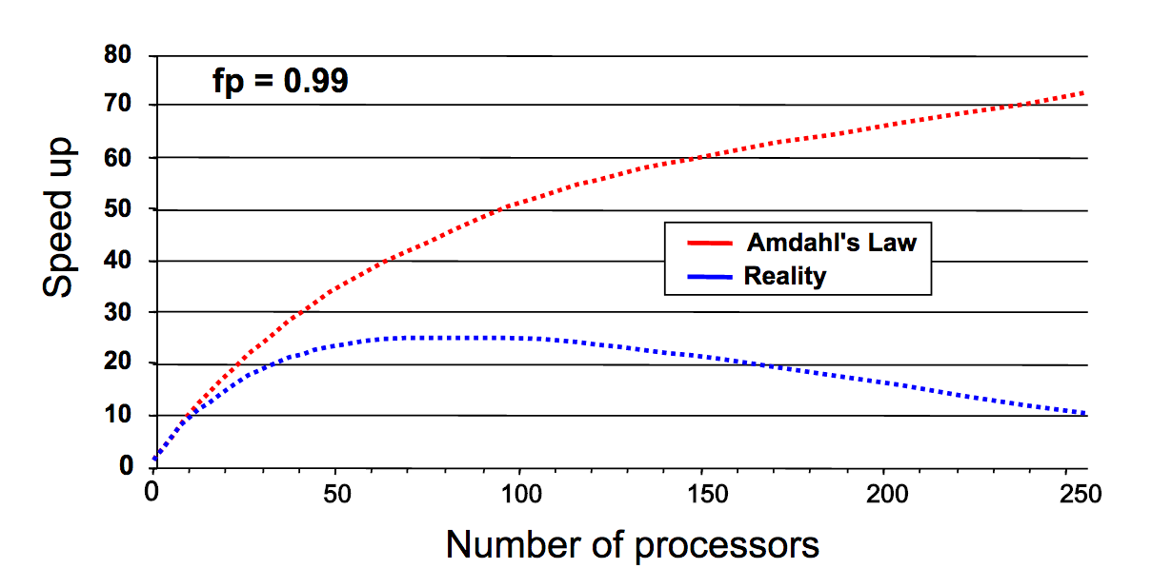
In Reality
Reality set in
Expect to lag behind perfection.
Expect a sweet spot beyond which adding processors will make things worse. (Scaling study in necessary)
Reasons:
Various kinds of overhead
Communication costs
Load imbalances

Slide 14
Message Passing Interface
MPI (Message Passing Interface) is a specification for message passing library that is standardized by MPI Forum.
Multiple vendor-specific implementations: MVAPICH, Intel-MPI, IBM MPI, OpenMPI.
MPI speicifications have been defined both C and Fortran, most recent version is MPI-3.
Over 100 advanced routines but 6-10 basic ones.

Slide 15
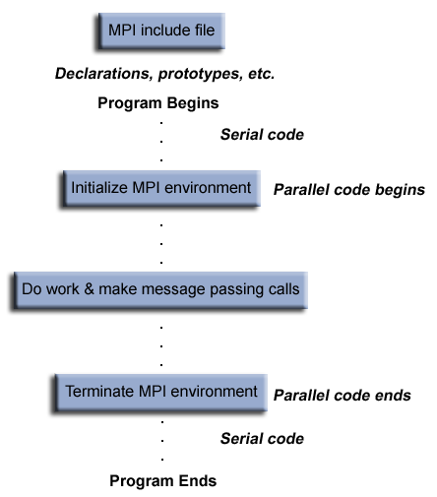
MPI Program Structure
Parallel code begins
Each process does some calculation and pass/receive messages to others
Parallel code ends

Slide 16
Divide & Conquer

Slide 17
Every MPI Program
Includes the MPI header file (mpi.h)
Has a routine to initialize the MPI environment (MPI_Init)
Has a routine to terminate the MPI environment (MPI_Finalize)
17

Slide 18
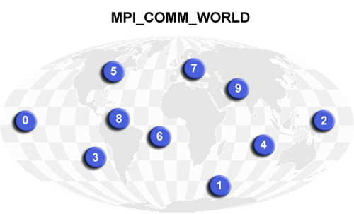
Communicators
Communicators are objects that are used to define which collection of processes may communicate with each other.
Multiple communicators can be defined.
Most MPI routines require a communicator as an argument.
MPI_COMM_WORLD is the predefined communicator that includes all MPI processes.
Rank: every process has its own unique, integer identifiers assigned by the system when the process initializes. Ranks are contiguous and begin at ZERO.

Slide 19
Typical Work Flow

Slide 20
The First MPI Code
#include <stdio.h>
int main() {
printf(“Wonderful Class!\n”);
return(0);
}

Slide 21
The First MPI Code
#include <stdio.h>
#include “mpi.h”
int main() {
printf(“Wonderful Class!\n”);
return(0);
}
Include the header file “mpi.h”

Slide 22
The First MPI Code
#include <stdio.h>
#include “mpi.h”
int main() {
MPI_Init(NULL, NULL);
printf(“Wonderful Class!\n”);
return(0);
}
Include the header file “mpi.h”
Start up MPI

Slide 23
The First MPI Code
#include <stdio.h>
#include “mpi.h”
int main() {
MPI_Init(NULL, NULL);
printf(“Wonderful Class!\n”);
MPI_Finalize();
return(0);
}
Include the header file “mpi.h”
Start up MPI
Shut down MPI

Slide 24
Compile & Run An MPI Code on Scholar
Intel compiler and Intel MPI library are recommended on Scholar.
Using module to set up the stack for MPI computations.
$ module load intel
$ module load impi
$ module list
Currently Loaded Modules:
1) intel/16.0.1.150 2) impi/5.1.2.150
After Feb. 1st, 2017, intel and impi will become default on Scholar
Notes:
Add information about hadoop and spark

Slide 25
Compile & Run An MPI Code on Scholar
 | Serial | MPI | OpenMP | MPI+OpenMP
Fortran | ifort | mpiifort | ifort -openmp | mpiifort -openmp
C | icc | mpiicc | icc -openmp | mpiicc -openmp
C++ | icpc | mpiicpc | icpc -openmp | mpiicpc -openmp
$ icc s_prog.c –o s_prog
$ ./s_prog
$ mpiifort p_prog.f90 -o p_prog
$ mpirun -np 8 ./p_prog
Notes:
Add information about hadoop and spark

Slide 26
The First MPI Code
#include <stdio.h>
#include “mpi.h”
int main() {
MPI_Init(NULL, NULL);
printf(“Wonderful Class!\n”);
MPI_Finalize();
return(0);
}
mpiicc first_mpi.c –o first_mpi
mpirun –np 8 ./first_mpi

Slide 27
The First MPI Code
$ mpirun –np 8 ./first_mpi
Wonderful Class!
Wonderful Class!
Wonderful Class!
Wonderful Class!
Wonderful Class!
Wonderful Class!
Wonderful Class!
Wonderful Class!

Slide 28
Another MPI Code
#include <stdio.h>
#include <mpi.h>
int main(int argc, char** argv) {
MPI_Init(NULL, NULL); // Initialize the MPI environment
int size;
MPI_Comm_size(MPI_COMM_WORLD,&size);//Get # of processes
int rank;
MPI_Comm_rank(MPI_COMM_WORLD,&rank);//Get rank of the process
printf("Hello world from processor %s, rank %d"
" out of %d processors\n",
processor_name, world_rank, world_size);
MPI_Finalize(); // Finalize the MPI environment.
}

Slide 29
Environment Management Routines
MPI_Init initializes the MPI execution environment. This function must be called in every MPI program, must be called before any other MPI functions and must be called only once in an MPI program.
C: MPI_Init (&argc, &argv)/MPI_Init(NULL, NULL)
FORTRAN: MPI_INIT(ierr)
MPI_Finalize Terminates the MPI execution environment. This function should be the last MPI routine called in every MPI program - no other MPI routines may be called after it.
C: MPI_Finalize ()
FORTRAN: MPI_FINALIZE(ierr)

Slide 30
Environment Management Routines
MPI_Comm_size returns the total number of MPI processes (size) in the specified communicator (comm), such as MPI_COMM_WORLD.
C: MPI_Comm_size (comm,&size)
FORTRAN: MPI_COMM_SIZE(comm,size,ierr)
MPI_Comm_rank determines the number of the process within a communicator, ranging from 0 to N-1.
C: MPI_Comm_rank (comm,&rank)
FORTRAN: MPI_COMM_RANK(comm,rank,ierr)
MPI_Wtime is a timer routine that returns elapsed wall clock time in seconds.
C: MPI_Wtime()
Fortran: MPI_WTIME()
Notes:
.If the communicator is MPI_COMM_WORLD, then it represents the number of MPI tasks available to your application.

Slide 31
Homework 0.2
Learn to set up MPI computing environment.
module load intel
module load impi
module list
Compile and run a MPI code.
1. copy either the C or Fortran code to your own account from /scratch/scholar/z/zhu472/me614
2. Compile the code
mpiicc helloworld.c –o helloworld
mpiifort helloworld.F90 –o hellworld
3. Do a quick run
mpirun –np 4 ./helloword
Notes:
.If the communicator is MPI_COMM_WORLD, then it represents the number of MPI tasks available to your application.

Slide 32
Type of Communications
Point-to-Point
Collective
Notes:
.If the communicator is MPI_COMM_WORLD, then it represents the number of MPI tasks available to your application.

Slide 33
Point-to-Point Communication
Involve message passing between two different MPI processes/tasks.
One task performs a send operation and the other task performs a matching receive operation.
There should be a matching receive routine for every send routine.
If a send is not paired with a matching receive then the code will have a deadlock.
http://www.mcs.anl.gov/research/projects/mpi/sendmode.html
Notes:
.If the communicator is MPI_COMM_WORLD, then it represents the number of MPI tasks available to your application.

Slide 34
Synchronous vs Asynchronous
Synchronous
Call does not return until the message is sent or received
Asynchronous
Call indicates a start of send or receive, and another call is made to determine if communication is finished.
http://www.mcs.anl.gov/research/projects/mpi/sendmode.html
Notes:
.If the communicator is MPI_COMM_WORLD, then it represents the number of MPI tasks available to your application.

Slide 35
Point-to-Point Communication
Notes:
.If the communicator is MPI_COMM_WORLD, then it represents the number of MPI tasks available to your application.

Slide 36
Point-to-Point Communication
http://www.mcs.anl.gov/research/projects/mpi/sendmode.html
Notes:
.If the communicator is MPI_COMM_WORLD, then it represents the number of MPI tasks available to your application.

Slide 37
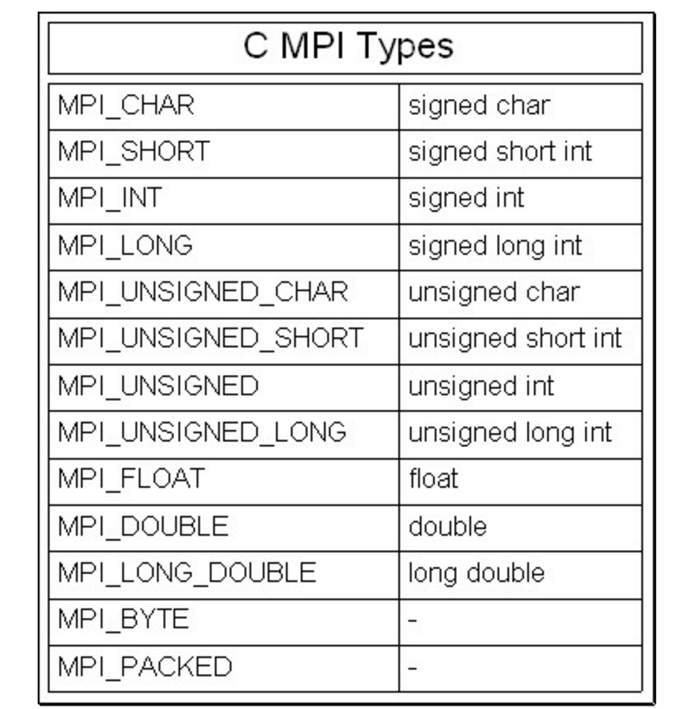
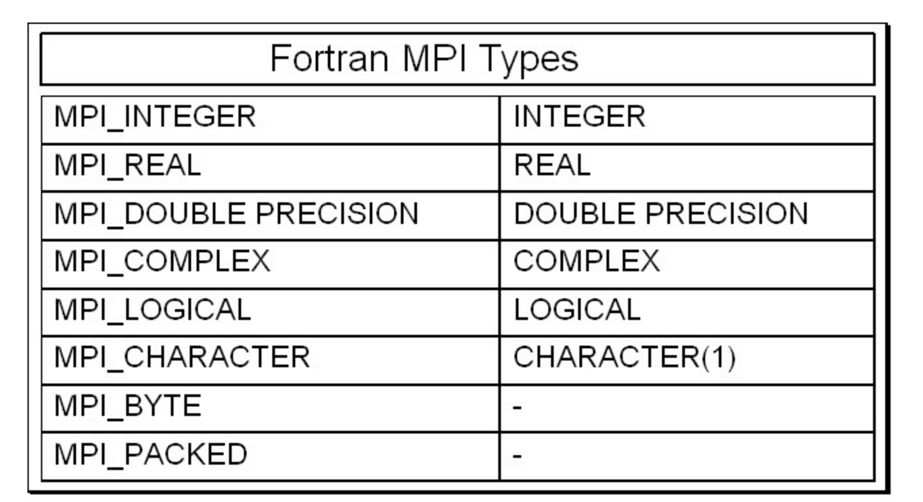
Data Type
When sending a message, it is given a data type;
MPI has many predefined types correspond to “normal” types;
Can create user-defined types.

Slide 38
Point-to-Point Communication
// Find out rank, size
int rank, size;
MPI_Comm_rank(MPI_COMM_WORLD, &rank);
MPI_Comm_size(MPI_COMM_WORLD, &size);
int number;
if (rank == 0) {
number = -1;
MPI_Send(&number, 1, MPI_INT, 1, 0, MPI_COMM_WORLD);
} else if (rank == 1) {
MPI_Recv(&number, 1, MPI_INT, 0, 0, MPI_COMM_WORLD,
MPI_STATUS_IGNORE);
printf(”Task 1 recv number %d from task 0\n", number);
}
Notes:
.If the communicator is MPI_COMM_WORLD, then it represents the number of MPI tasks available to your application.

Slide 39
Point-to-Point Communication
if (rank == 0) {
dest = 1;
source = 1;
MPI_Send (&outmsg,1,MPI_CHAR,dest,tag, MPI_COMM_WORLD);
MPI_Recv (&inmsg,1,MPI_CHAR,source,tag, MPI_COMM_WORLD,&Status);
} else if (rank == 1){
dest = 0;
source = 0;
MPI_Send (&outmsg,1,MPI_CHAR,dest,tag, MPI_COMM_WORLD);
MPI_Recv (&inmsg,1,MPI_CHAR,source,tag, MPI_COMM_WORLD,&Status);
}
Is the code going to run?
Notes:
.If the communicator is MPI_COMM_WORLD, then it represents the number of MPI tasks available to your application.

Slide 40
Collective Communications
Defined as communication between > 2 processes
One-to-many, many-to-one, many-to-many
All processes within the communicator call the same collective communication function with matching argument.

Slide 41
Collective Communications
Synchronization (Barrier)
Data Movement (Broadcast, Scatter, Gather, etc)
Collective Computation (Reduce, Allreduce)

Slide 42
Synchronization
MPI_Barrier creates a barrier synchronization in a group.
Each task, when reaching the MPI_Barrier call, blocks until all tasks in the group reach the same MPI_Barrier call
MPI_Barrier (comm)
NO data exchange
42

Slide 43
DATA MOVEMENT
43

Slide 44
Collective Computation
MPI_Reduce applies a reduction operation on all tasks in a group and places the result in one task(root).
MPI_Reduce ( &sendbuf, &recvbuf, count, datatype, mpi_red_op, root, comm)
MPI_Allreduce applies a reduction operation on all tasks in a group and passes the result to all tasks.
MPI_Allreduce ( &sendbuf, &recvbuf, count, datatype, mpi_red_op, comm)
Often used mpi_red_op includes: MPI_MAX, MPI_MIN, MPI_SUM, MPI_PROD. User can also define own reduce operation.
44

Slide 45
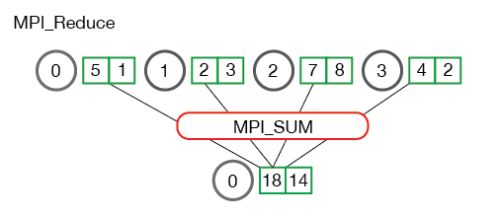
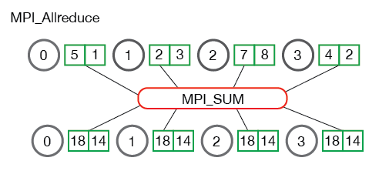
Collective Computation
45

Slide 46
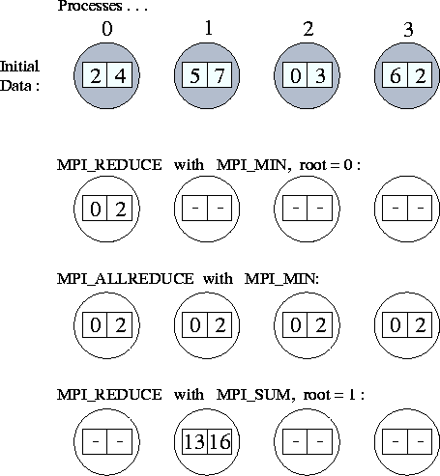
Collective Computation
46

Slide 47
One more example – for loop
#include <stdio.h>
int main(int argc,char *argv[]){
int i, sum, upToVal;
upToVal = 10000;
sum=0;
for(i=1; i<= upToVal; i++){
sum = sum +i;
}
printf("\nSum is %d\n", sum);
return 0;
}
47

Slide 48
One more example – for loop
#include <stdio.h>
#include <mpi.h>
int main(int argc,char *argv[]){
int i, sum, upToVal;
upToVal = 10000;
sum=0;
int totalTasks, myRank;
MPI_Init( &argc, &argv );
MPI_Comm_size( MPI_COMM_WORLD, &totalTasks );
MPI_Comm_rank( MPI_COMM_WORLD, &myRank );
for(i=1; i<= upToVal; i++){
sum = sum +i;
}
printf("\nSum is %d\n", sum);
MPI_Finalize();
return 0;
}
48

Slide 49
One more example – for loop
Task 0
Task 1
Task 2
Task 3
start end
start end
start end
start end
partial_sum
partial_sum
partial_sum
partial_sum
int start, end;
start = myRank*(upToVal/totalTasks) + 1
if (myRank == 0){end = upToVal}
else {end = start + upToVal/totalTasks - 1}
for(i=start; i<= end; i++){
partial_sum = partial_sum +i;
}
49

Slide 50
One more example – for loop
Task 0
Task 1
Task 2
Task 3
start end
start end
start end
start end
partial_sum
partial_sum
partial_sum
partial_sum
sum
Task 0
Task 1 to totalTasks - 1 send partial_sum to task 0
Tasks 0 receives partial_sum from task 1 to totalTasks - 1
50

Slide 51
One more example – for loop
if ( myRank == 0 ){
sum=partial_sum;
for (i=1;i<totalTasks;i++) {
MPI_Recv( &partial_sum, 1 , MPI_INT, i ,0, MPI_COMM_WORLD, MPI_STATUS_IGNORE);
sum+=partial_sum;
}
printf("\nSum is %d\n", sum);
}
else{
MPI_Send( &partial_sum, 1 , MPI_INT, 0, 0, MPI_COMM_WORLD);
}
51

Slide 52
One more example – for loop
if ( myRank == 0 ){
sum=partial_sum;
for (i=1;i<totalTasks;i++) {
MPI_Recv( &partial_sum, 1 , MPI_INT, i ,0, MPI_COMM_WORLD, MPI_STATUS_IGNORE);
sum+=partial_sum;
}
printf("\nSum is %d\n", sum);
}
else{
MPI_Send( &partial_sum, 1 , MPI_INT, 0, 0, MPI_COMM_WORLD);
}
52

Slide 53
One more example – for loop
if ( myRank == 0 ){
sum=partial_sum;
for (i=1;i<totalTasks;i++) {
MPI_Recv( &partial_sum, 1 , MPI_INT, MPI_ANY_SOURCE ,0, MPI_COMM_WORLD, MPI_STATUS_IGNORE);
sum+=partial_sum;
}
printf("\nSum is %d\n", sum);
}
else{
MPI_Send( &partial_sum, 1 , MPI_INT, 0, 0, MPI_COMM_WORLD);
}
53

Slide 54
One more example – for loop
Task 0
Task 1
Task 2
Task 3
start end
start end
start end
start end
partial_sum
partial_sum
partial_sum
partial_sum
sum
Task 0
Task 1 to totalTasks - 1 send partial_sum to task 0
Tasks 0 receives partial_sum from task 1 to totalTasks - 1
54

Slide 55
Documentation
Parallel Computing Books
http://pages.tacc.utexas.edu/~eijkhout/istc/istc.html
MPI Standard
http://www.mcs.anl.gov/research/projects/mpi/
http://mpi-forum.org/
MPI Books:
http://mpitutorial.com/recommended-books/
http://www.netlib.org/utk/papers/mpi-book/mpi-book.html
MPI Tutorials:
http://mpitutorial.com/tutorials/
https://computing.llnl.gov/tutorials/mpi/
OpenMP specification:
http://www.openmp.org/
OpenMP Tutorials:
https://computing.llnl.gov/tutorials/openMP/

